Slide 1

Final Presentation
Compassionate Decision Support for Patients & Families Choosing Care Services
DSCI 5260.501 Business Process Analytics
Group 1 – April 30th, 2025
Anusha Basam, Aoi Ikemori, Bhavana Chittineni and Vandana Kolla

Slide 2

Types of post-acute care and challenges with accepting Medicare
Skilled Nursing Facilities - SNF
Long Term Care Hospitals - LTC
Inpatient Rehabilitation Facilities - IRF
Home Health Agencies- HH
Hospice Care - HOS
Challenges
Fixed Reimbursement Rates
Payment Delays
Audit and regulatory compliance
Complex billing and documentation requirements
Raising operational costs
Notes:
For our research we will be focusing on t

Slide 3
Problem statement
Problem Statement
Lack of readable comprehensive information, based on which elderly patients and family members can make informed decisions to choose the best post acute care facilities that fits their needs.

Slide 4

Focused Research Questions
Medicare Payment Amount- All Service Categories
Medicare Payment Amount per Service Category
State with the highest number of Providers
State with the highest number of Patients
This Photo by Unknown Author is licensed under CC BY-SA-NC

Slide 5

Dataset – Source, Size, and Variables
Category | Details
Total Rows | 89393
Total Columns | 88
Data Levels | Provider-level, State-level, National-level
PAC Settings Covered | Home Health, Hospice, Skilled Nursing Facilities (SNFs), Inpatient Rehabilitation Facilities ( IRFs), Long-Term Care Hospitals (LTCHs)
Included Details | Beneficiary demographics, Service utilization, Conditions, Medicare payments
Key Metrics | Total stays, Charges, Payments, Therapy minutes
Additional Tracking | Diagnoses, Dual eligibility, Rural classifications for beneficiaries

Slide 6
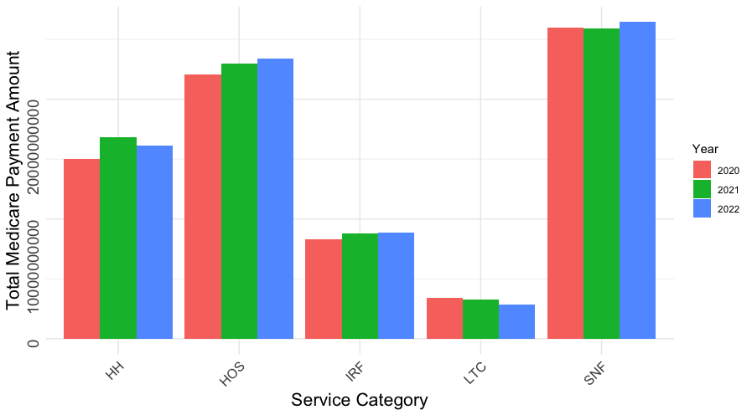
Insights from Exploratory Data Analysis
Total Medicare Payments by Service Category
"Skilled Nursing Facility (SNF) has the highest total Medicare Payment across all Service Categories over three years."

Slide 7
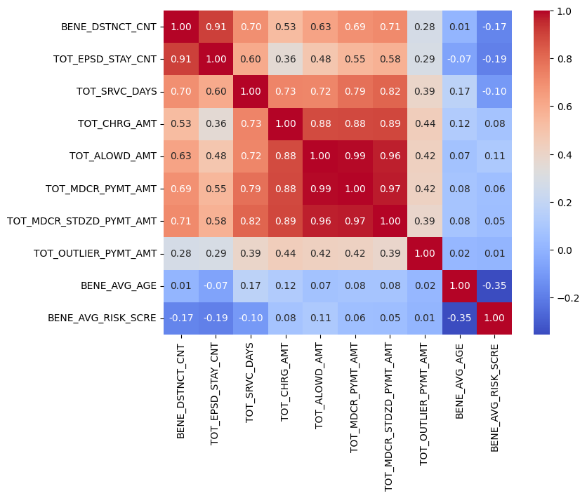
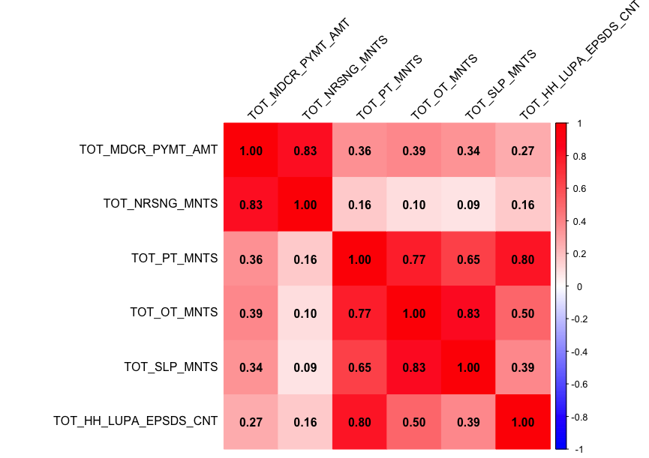
Insights from Exploratory Data Analysis
Correlation Heatmap for Providers’ Data
Correlation Heatmap for Medicare Payment and
Service Minutes

Slide 8
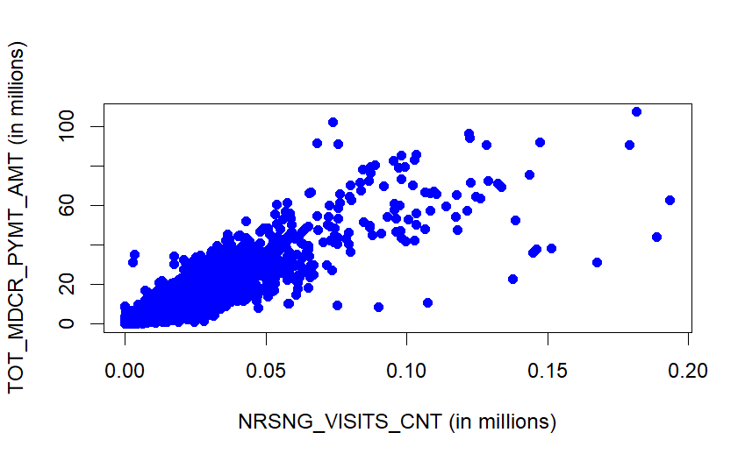
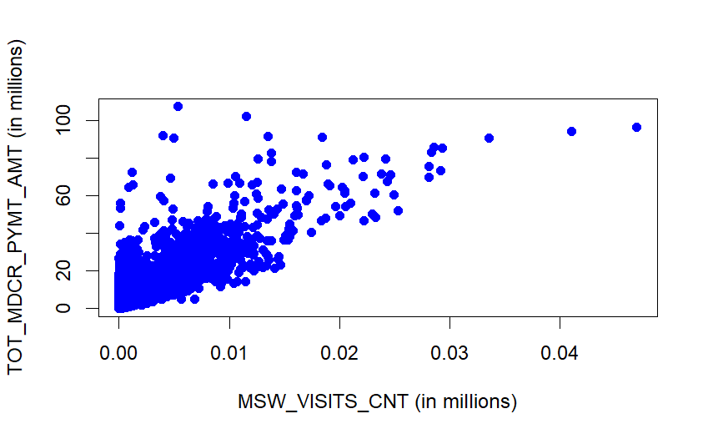
Relationship between Medicare Payments, Nursing visits and Social Work visits
Nursing visits excluding outliers
Social work visits excluding outliers
Positive correlation between total payment amount & nursing and social work visits

Slide 9
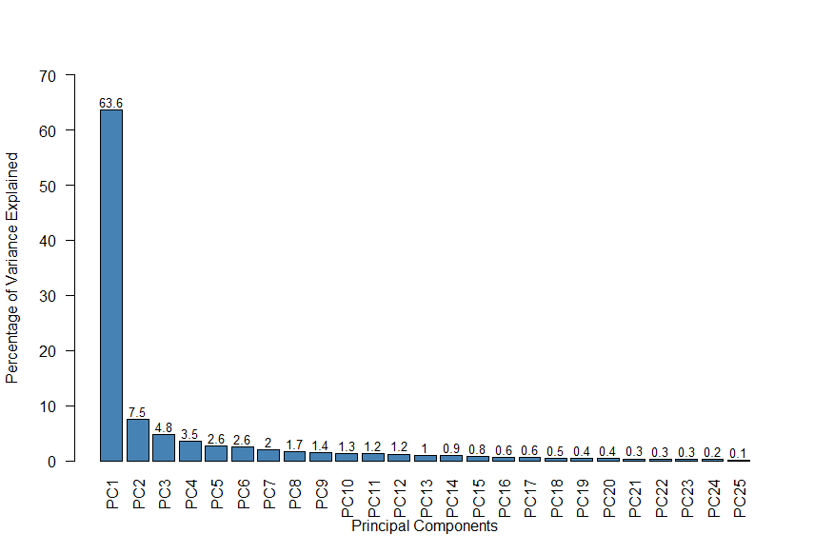
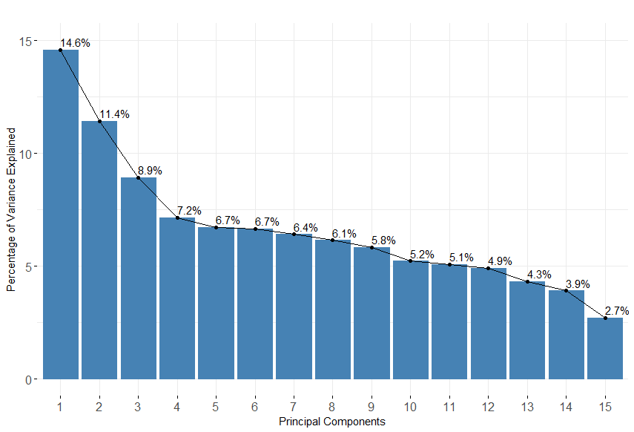
Data Preparation and Analysis Techniques
Dealing with Missing Values
Data Exclusion
Outlier Analysis
Dimension Reduction
Scree plot (Chronic conditions)
Scree plot (Primary diagnosis)

Slide 10

Methodologies
Dimension Reduction
Variable Selection
Multiple Linear Regression
Elastic Net Regression

Slide 11


Results
Multiple Linear Regression vs Elastic Net Regression
Metric | Multiple Linear Regression |  | Elastic Net Regression
 | Value | vs Elastic | Value | vs Linear
ME | 3,826 |  | 3,851
RMSE | 1,615,535 |  | 1,615,874
MAE | 730,076 |  | 730,020
MPE | -22.26% |  | -23.50%
MAPE | 60.73% |  | 61.13%
R²adj | 93.34% |  | 91.97%
Model Comparison
Target variable:
Total Medicare Payment Amount
Multiple Linear Regression has better performance than Elastic Net Regression.
Multiple Linear Regression segmented by each service category has better accuracy
However, LTC/IRF have higher errors
Multiple Linear Regression
(All service categories vs Each service category)
Metric | All service categories | HH | HOS | SNF | LTC | IRF
ME | 3,826 | 9,222 | -1,083 | -2,629 | 186,785 | 63,894
RMSE | 1,615,535 | 525,463 | 764,216 | 508,634 | 1,768,454 | 1,751,417
MAE | 730,076 | 254,789 | 426,632 | 289,377 | 1,296,739 | 1,144,516
MPE | -22.26% | -1.96% | 5.81% | 1.40% | -10.49% | -9.24%
MAPE | 60.73% | 26.90% | 19.18% | 18.84% | 22.46% | 21.67%
R²adj | 93.34% | 96.20% | 97.41% | 92.82% | 88.13% | 91.78%

Slide 12
Results
Coefficients of each predictor:
Predictors | Coefficients | P-value
(Intercept) | 311,374.74 | <0.001
Number of beneficiaries | 5,515.37 | <0.001
Days of Service | 206.94 | <0.001
Nursing Visit Count | -161.46 | <0.001
Social Work Visit Count | -896.89 | <0.001
Total Physical Therapy Minutes | -7.63 | <0.001
Total Occupational Therapy Minutes | 26.36 | <0.001
Count of HH Episodes with few visits | -12,779.29 | <0.001
PC1_% of Beneficiaries with Chronic Conditions | -121,311.23 | <0.001
Final Model Selection
Target Variable:
Total Medicare Payment Amount
Final Model:
Multiple Linear Regression
(for all service categories)
Blue: Positive correlation​ Orange: Negative correlation
Accuracy (Validation set) :
Metric | Value | Description
ME | 3,826 | Slightly overpredicts by about 3.8K.
RMSE | 1,615,535 | Predictions are off by around 1.62 million on avg. (Might be due to outliers)
MAE | 730,076 | Predictions are off by about 730K from the actual.
MPE | -22.26% | Underpredicts by about 22% on avg.
MAPE | 60.73% | Predictions are off by about 61% on avg.
There is room to improve predictive accuracy.

Slide 13
Conclusions
Key Positive Contributors:
Number of beneficiaries, total service days, and occupational therapy minutes
Negative Contributors:
Nursing visits, social work visits, physical therapy minutes, low utilization payment episodes, PC for chronic conditions.
Some negative effects remain unexplained, indicating opportunities for further research.
Limitations:
Data limitation
Implication:
Analysis findings highlight the obvious importance of patient volume and service duration on payment, need for comprehensive data to fully understand payment drivers.

Slide 14
Research Answers
Medicare Payment Amount- All Service Categories:
Favorable: Beneficiaries count, service days, OT minutes
Adverse : Nursing visits, SW visits, PT minutes, low-utilization episodes, PC for chronic conditions.
Medicare Payment Amount per Service Category:
Regression results show variation in impact across categories
Some attributes are more influential in specific services (e.g., therapy minutes vs. nursing visits)

Slide 15
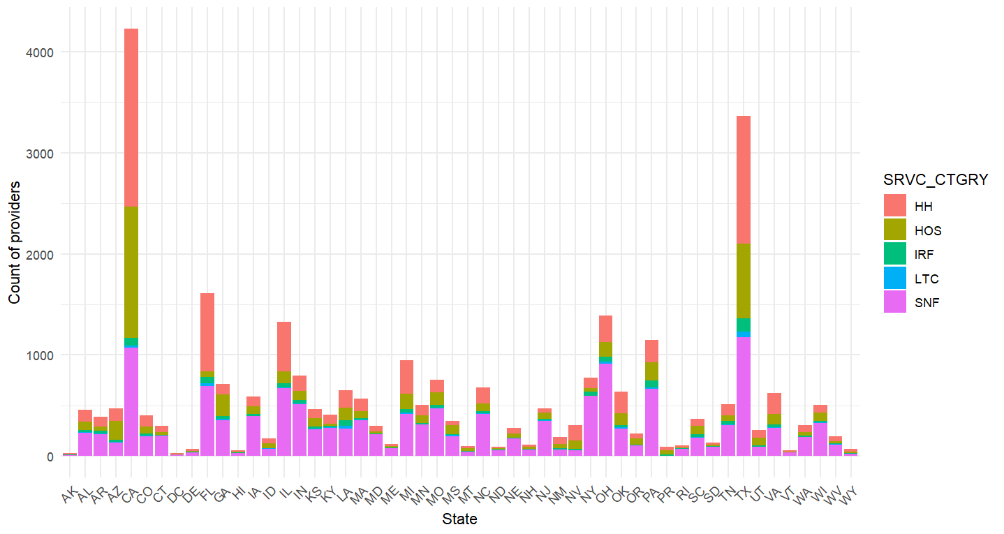
Research Answers(Contd..)
State with the highest number of Providers
Largest segments in each service category - CA, TX, and FL

Slide 16
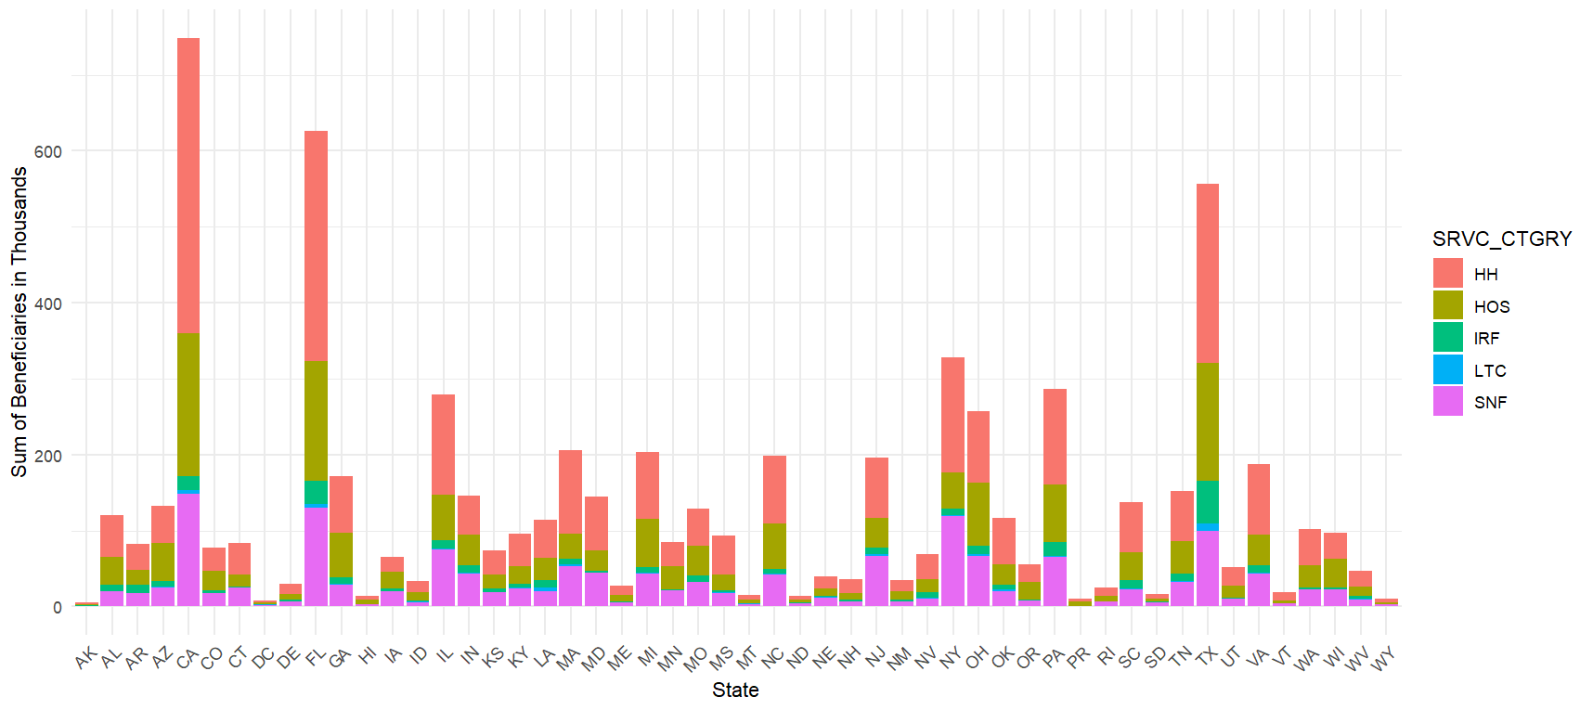
Research Answers(Contd..)
State with the highest number of Patients
Largest segments in each service category - CA, FL, TX

Slide 17

Limitations
Obvious observations
Service Category level attributes
Unavailability of Provider level parameters
Patient cost

Slide 18

Future research considerations
Deeper Service category level analysis.
More analysis on the attributes with negative coefficients.
Cost saving opportunities.

Slide 19

Thank you

